Slide 1
STOR 455 Polynomial Regression and Overfitting
Read: 3.3, 3.4, 3.6
Exercises: 3.35, 36, 37, 38, 41, 42

Slide 2
Extra Credit Project: Wrong Linear Models
Finding misuse of linear models in publications.
Statistics is a new subject, and statistical mistakes are very common.
Look up from the news, from the library, from the web, or from any source. Report your finding and get up to 1% extra credit.
Format of the report:
Part 1: Clearly state the source of the publication(news, magazines, blogs...).
Part 2: A short paragraph about why it is wrong. 0.5%
Part 3: A short paragraph about what the right procedure is. 0.5%
Upload the pdf file of your report to Sakai by 5pm on April 29.
A maximum of 1 typed page including all your analysis, 12 point font, double spaced. Violations of the format will result in a 0 in grade.
Work independently. No shared credit. Identical submissions will receive a grade of 0 and will be investigated.

Slide 3
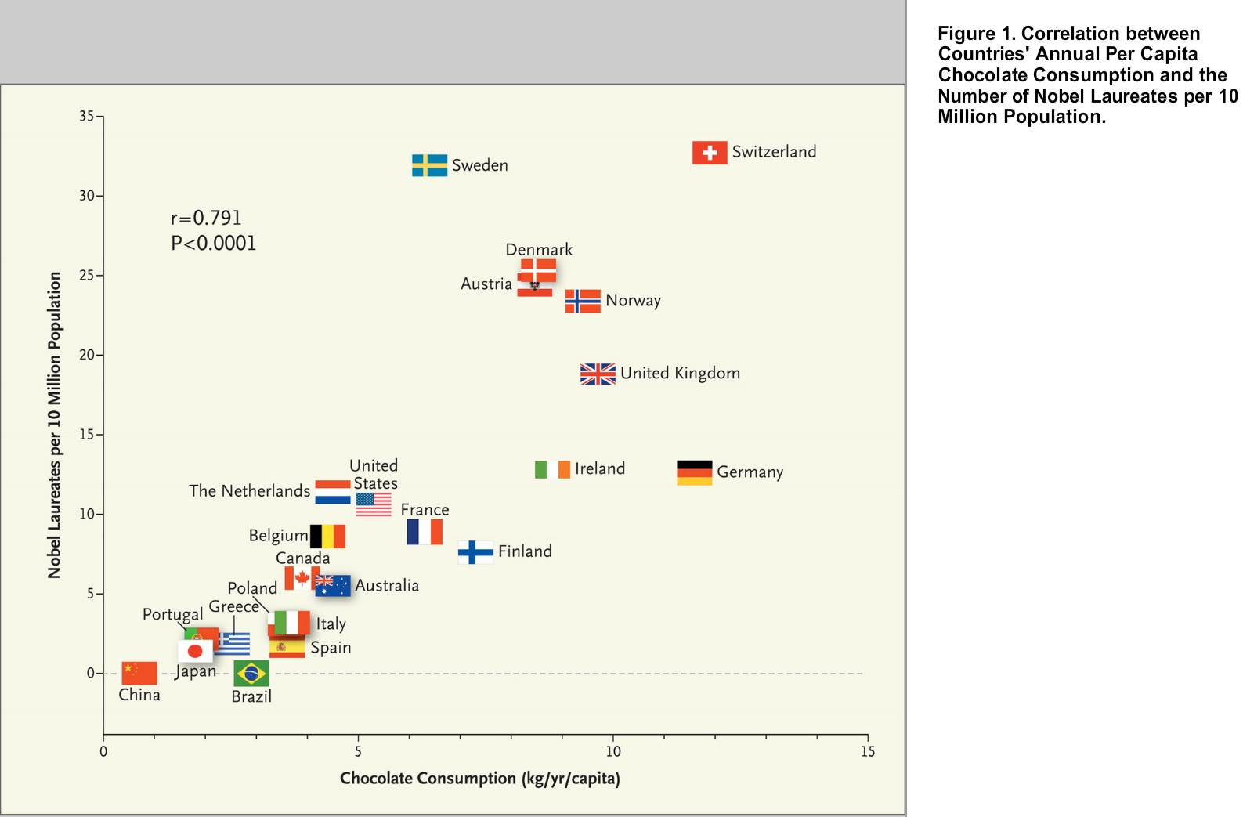
More Chocolate, More Nobel Prize Winners?
A study was published in New England Journal of Medicine, one of the most prestigious journals in medicine. Causation between chocolate consumption per capita and the number of Nobel prize winners per capita is claimed.

Slide 4
Problems in this study
Correlation doesn't mean causation!!
Problems in data collection: Chocolate consumption data are from a Swiss chocolate company.
Problems from lurking variables: Income per capita for example.
Problems of influential observations:
Luxembourg: 4.4 kg per year per capita, 39.287 Nobel laureates per 10 million people.
Saudi Arabia and UAE: 13 and 11.5 kg per year per capita respectively, 0 Nobel Prize winners.

Slide 5
Example: State SAT Scores
Source: Statistical Sleuth, Case 12.1 pg. 339
Response Variable:
SAT =Average combined SAT Score
Potential Predictors:
Takers = % taking the exam
Income = median family income ($100’s)
Years = avg. years of study (SS, NS, HU)
Public = % public school
Expend = spend per student ($100’s)
Rank = median class rank of takers

Slide 6
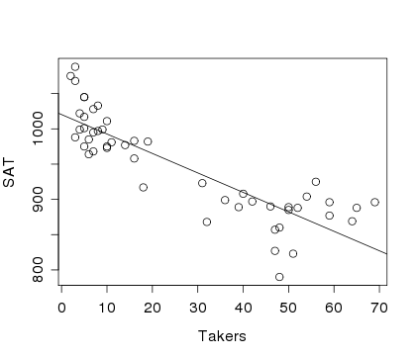
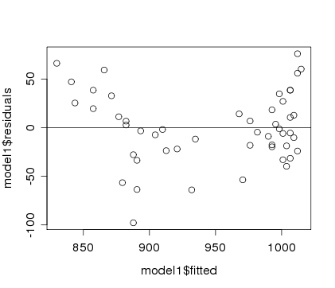
Example: State SAT
Model #1: Y=SAT vs. X=Takers
Would a “curved” line work better?
modSAT1=lm(SAT~Takers,data=StateSAT)
summary(modSAT1)
Estimate Std. Error t value Pr(>|t|)
(Intercept) 1020.3062 8.1391 125.36 < 2e-16 ***
Takers -2.7600 0.2387 -11.56 1.77e-15 ***
---
Residual standard error: 36.8 on 48 degrees of freedom
Multiple R-squared: 0.7358, Adjusted R-squared: 0.7303
F-statistic: 133.7 on 1 and 48 DF, p-value: 1.768e-15

Slide 7
Polynomial Regression
For a single predictor X:
(linear)
(quadratic)
(cubic)

Slide 8
Polynomial Regression in R
Method #1: Create new variables with predictor powers.
StateSAT$TakersSq=StateSAT$Takers^2
modSATquad1=lm(SAT~Takers+TakersSq,data=StateSAT)
To avoid creating a new variable…
Method #2: Use I( )in the lm( )
modSATquad2=lm(SAT~Takers+I(Takers^2),data=StateSAT)
Method #3: Use poly
modSATquad3=lm(SAT~poly(Takers,degree=2,raw=TRUE), data=StateSAT)

Slide 9
Quadratic model for SAT
modSATquad2 = lm(SAT~Takers+I(Takers^2),data=StateSAT)
summary(modSAT2I)
Coefficients:
Estimate Std. Error t value Pr(>|t|)
(Intercept) 1053.13112 9.27372 113.561 < 2e-16 ***
Takers -7.16159 0.89220 -8.027 2.32e-10 ***
I(Takers^2) 0.07102 0.01405 5.055 6.99e-06 ***
Residual standard error: 29.93 on 47 degrees of freedom
Multiple R-squared: 0.8289, Adjusted R-squared: 0.8216
F-statistic: 113.8 on 2 and 47 DF, p-value: < 2.2e-16
$$\hat{SAT}=1053.1−7.1616Takers+0.0710{Takers}^{2}$$

Slide 10
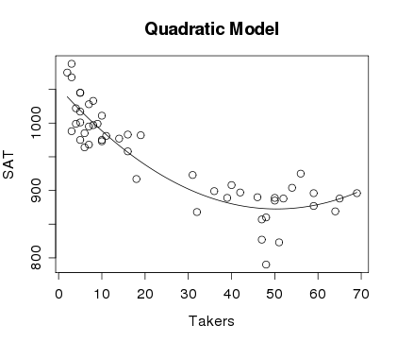
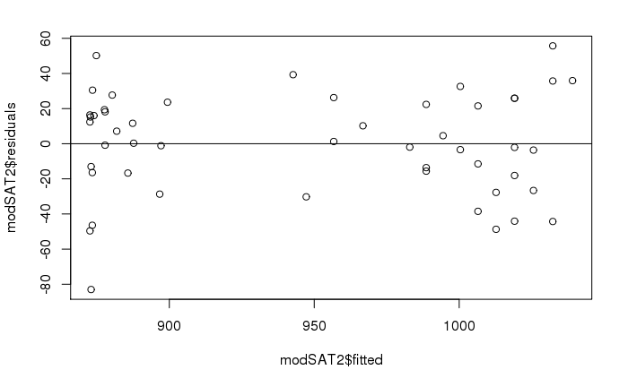
Quadratic model for SAT
plot(SAT~Takers,main="Quadratic Model",data=StateSAT)
B0_modSATquad2 = summary(modSATquad2)$coef[1,1]
B1_modSATquad2 = summary(modSATquad2)$coef[2,1]
B2_modSATquad2 = summary(modSATquad2)$coef[3,1]
curve(B0_modSATquad2 + B1_modSATquad2*x
+ B2_modSATquad2*x^2, add=TRUE)

Slide 11
Second Order Models
Definition: A second order model for two quantitative predictors would be
first order
quadratic
interaction
second order
Example: Try a full second order model for
Y=SAT using X₁=Takers and X₂=Expend

Slide 12
Second Order Model for State SAT
modSAT2ndorder = lm(SAT~Takers+Expend+I(Takers^2)+I(Expend^2)+I(Takers*Expend),data=StateSAT)
summary(modSAT2ndorder)
Coefficients:
Estimate Std. Error t value Pr(>|t|)
(Intercept) 893.66283 36.14094 24.727 < 2e-16 ***
Takers -7.05561 0.83740 -8.426 9.96e-11 ***
Expend 10.33333 2.49600 4.140 0.000155 ***
I(Takers^2) 0.07725 0.01328 5.816 6.28e-07 ***
I(Expend^2) -0.11775 0.04426 -2.660 0.010851 *
I(Takers * Expend) -0.03344 0.03716 -0.900 0.373087
---
Residual standard error: 23.68 on 44 degrees of freedom
Multiple R-squared: 0.8997, Adjusted R-squared: 0.8883
F-statistic: 78.96 on 5 and 44 DF, p-value: < 2.2e-16
Do we need the interaction term?
Do we need the second order terms?
Do we need the terms with Expend?

Slide 13
Example: State SAT Scores #2
Source: Statistical Sleuth, Case 12.1 pg. 339
Response Variable:
SAT =Average combined SAT Score
Potential Predictors:
Takers = % taking the exam
Income = median family income ($100’s)
Years = avg. years of study (SS, NS, HU)
Public = % public school
Expend = spend per student ($100’s)
Rank = median class rank of takers
Region = U.S. Geographical Region

Slide 14
Quadratic model for SAT with an Interaction
modSATquad2_byregion = lm(SAT ~
Takers +
I(Takers^2) +
Region +
Takers*Region +
I(Takers^2)*Region,
data=StateSAT2
)
How many terms are in this model?

Slide 15
Nested F-test
H₀: β_{i} = 0
H_{a}: Some β_{i} ≠ 0
For i ∈ {3, 4, 5 … 14}
anova(modSATquad2, modSATquad2_byregion)
Analysis of Variance Table
Model 1: SAT ~ Takers + I(Takers^2)
Model 2: SAT ~ Takers + I(Takers^2) + Region + Takers * Region + I(Takers^2) * Region
Res.Df RSS Df Sum of Sq F Pr(>F)
1 47 42101
2 35 16668 12 25433 4.4505 0.0002619 ***

Slide 16
Would a Cubic work better?
modSATcubic = lm(SAT~Takers+I(Takers^2)+I(Takers^3),data=StateSAT)
summary(modSATcubic)
Estimate Std. Error t value Pr(>|t|)
(Intercept) 1.051e+03 1.452e+01 72.366 < 2e-16 ***
Takers -6.753e+00 2.380e+00 -2.837 0.00676 **
I(Takers^2) 5.631e-02 8.051e-02 0.699 0.48777
I(Takers^3) 1.408e-04 7.586e-04 0.186 0.85353
---
Residual standard error: 30.24 on 46 degrees of freedom
Multiple R-squared: 0.829, Adjusted R-squared: 0.8178
F-statistic: 74.33 on 3 and 46 DF, p-value: < 2.2e-16
modSATquad2 = lm(SAT~Takers+I(Takers^2),data=StateSAT)
summary(modSATquad2)
Residual standard error: 29.93 on 47 degrees of freedom
Multiple R-squared: 0.8289, Adjusted R-squared: 0.8216
F-statistic: 113.8 on 2 and 47 DF, p-value: < 2.2e-16

Slide 17
Nested F-test
$$SAT =β_{0}+β1Takers+_{2}Takers2+ 3Takers3+ε$$
H₀: β₃=0
H_{a}: Some β₃≠0
anova(modSATquad2, modSATcubic)
Analysis of Variance Table
Model 1: SAT ~ poly(Takers, degree = 2, raw = TRUE)
Model 2: SAT ~ Takers + I(Takers^2) + I(Takers^3)
Res.Df RSS Df Sum of Sq F Pr(>F)
1 47 42101
2 46 42069 1 31.524 0.0345 0.8535

Slide 18
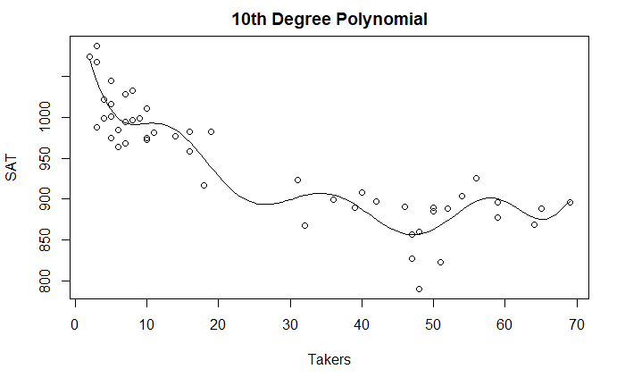
How High to Go?

Slide 19
Nested F-test
H₀: β_{i} = 0
H_{a}: Some β_{i} ≠ 0
For i ∈ {3, 4, 5 … 10}
anova(modSATquad2, modSAT10)
Analysis of Variance Table
Model 1: SAT ~ Takers + I(Takers^2)
Model 2: SAT ~ poly(Takers, degree = 10, raw = TRUE)
Res.Df RSS Df Sum of Sq F Pr(>F)
1 47 42101
2 39 34057 8 8044.1 1.1515 0.3524

Slide 20
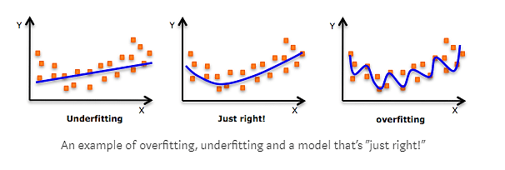
Overfitting
Concern: A model may reflect the structure of a particular sample, but not generalize well to the population.

Slide 21
Cross Validation
Concern: A model may reflect the structure of a particular sample, but not generalize well to the population.
To see if this is a problem:
Split the original sample into two parts
(a) A “training” sample to build a model
(b) A “holdout” sample to test the model

